Slide 1
Anthology ALIGNMENT PROJECT
Council of the Great City Schools
and
Student Achievement Partners
Notes:
This module was last updated on February 2016.
QUESTIONS WELCOME THROUGHOUT----NOT HERE TO denigrate Anthologies– THIS GENERATION WAS DESIGNED FOR DIFFERENT STANDARDS
SOME OF WHAT WE GO OVER HERE IS IN WRITTEN INTRODUCTION---VAST MAJORITY OF LEARNING WILL COME FROM WORK IN GROUPS
GREAT LEVERAGE HERE CGCS/SAP/STATES/DISTRICTS! COMMON EFFORT FOR ALL OUR STUDENTS. HARD WORK, BUT THE EPITOME OF “WORK WORTH DOING”

Slide 2
The Anthology Alignment Project:
Work worth doing to deeply understand the ELA standards
Provides the ‘common’ in Common Core by leveraging all of us here and beyond to:
  Create questions worth answering
  Develop prompts worth writing about
  Spotlight the texts worthy of deepest attention
Notes:
Robin and Meredith both need to step up this exhorting!

Slide 3
Anthologies: a GREAT resource
But:
They move too quickly through the texts.
Culminating assignments are often not text dependent
Frequently focus on either discrete comprehension strategies or literary analysis beyond that called for by CCSS
Tend to focus on only that aspect. So the text is in service to the learning goal instead of vice versa.
Do not focus strongly enough on academic language
Notes:
THIS IS WHERE WE WILL PUT OUR WORK—LITTLE MATTERS IF THIS IS NOT CHANGED---WORD ON COMPREHENSION STRATEGIES. TEACHERS NEED ALIGNED MATERIAL IN THEIR HANDS, STUDENTS NEED ALIGNED MATERIAL TO WORK WITH.

Slide 4
Anthologies are not aligned:
Some number of texts not aligned in terms of complexity (“Rikki-Tikki-Tavi”)
Don’t have the balance of literary non-fiction to narrative literature called for by CCSS
This AAP project cannot directly address these types of issues, except by juggling the texts chosen for revision in each series.
Notes:
WE CANNOT ADDRESS THESE, MAYBE ON A WEBINAR OR CHAT DURING THE WRITING PERIOD—
WILL INSTEAD ADDRESS OTHER AREAS BEGINNING WITH TEXT DEPENDENT QUESTIONS---SPIKES OF COMPLEXITY

Slide 5
WHAT WE WILL NOT BE DOING
Will not alter sections on grammar, usage, morphology, connections
Will not be supporting any supplemental texts
Will not do anything about the existing complexity of texts except use in considering what selections to revise.
Will take longer for students and teachers to work through these aligned sets of questions and tasks.
Notes:
Need to say why in each case. Refer to overview intro that will accompany each set of revisions.

Slide 6
WHAT TEXT-DEPENDENT QUESTIONS ARE:
Questions that can only be answered with evidence from the text
Can be literal but can also involve analysis, synthesis, evaluation
Focus on word, sentence and paragraph as well as larger ideas, themes or events
Focus on difficult portions of text in order to enhance reading proficiency
Much more detail is in your guides
Notes:
LEARN ABOUT THIS BY DOING IT AND THIS IS A REAL DOING TWO DAYS

Slide 7
WHY TEXT-DEPENDENT QUESTIONS? or, WHY NOT GO OUTSIDE THE TEXT?
More time outside the text less inside
Going outside the text privileges those who have that experience
It is easier to talk about our experiences than to analyze the text
These are college and career standards
That being said….

Slide 8
THE ROLE OF PRE-READING
Multiple readings often make this unnecessary
Too often provides information students can glean from careful reading of the text- in many cases provides a complete summary
Almost impossible to wean students from this
Similarly challenging to move teachers away from providing this “smoothing of the road”
Research base?
Notes:
NOTE SHANAHAN BLOG

Slide 9
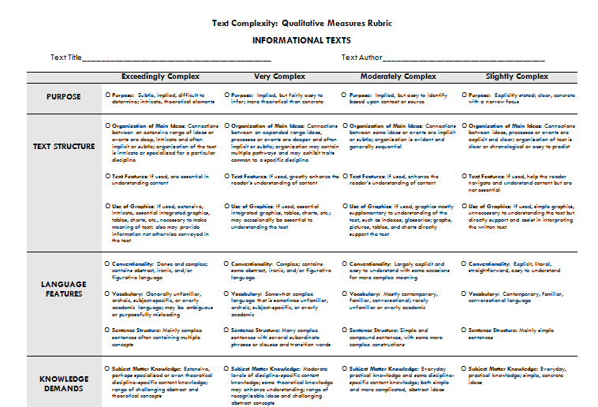
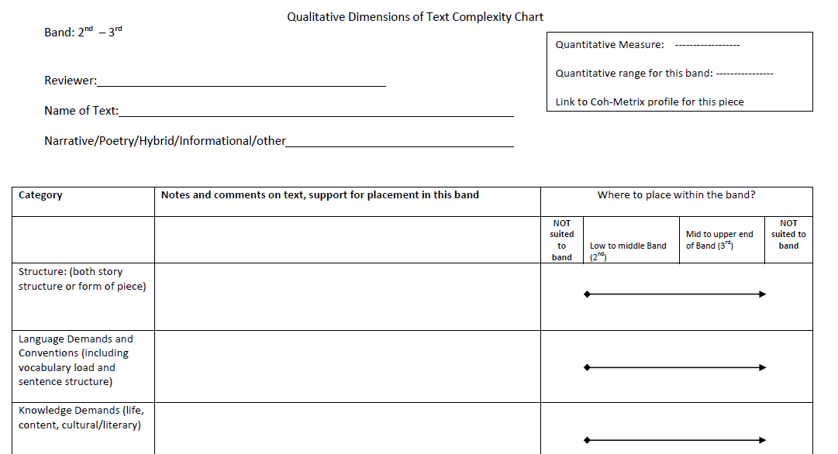
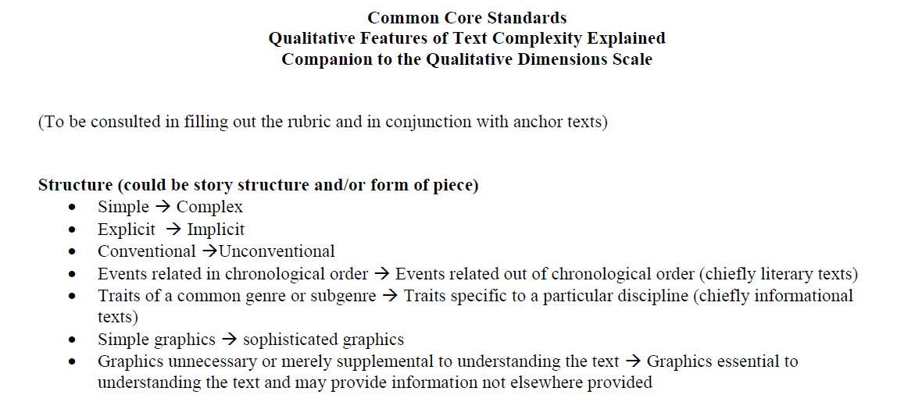
Tools for Evaluating Text Complexity
Rubric
Chart and Companion Guide
Refer to STEP 2 on the “Step-by-Step Checklist for Writers”
Notes:
This is potentially confusing so allow time for everyone to get oriented, realize there is a 6-8 version and a 9-10 version; both a scale and a rubric available. Also talk about alternative methods: annotating the text itself for these features, etc.
Make the connection to the text complexity triangle and Appendix A features of qual complexity.

Slide 10
Big Ideas, Key Understandings
Note the plurals!
Reverse-engineered or backwards-designed
Crucial for creating an overarching set of successful questions
Critical for creating an appropriate culminating assignment
Crucial for teachers to know about each text they read with students. We need to help them know by our careful work.
Allow for full exploration of the text under study.

Slide 11
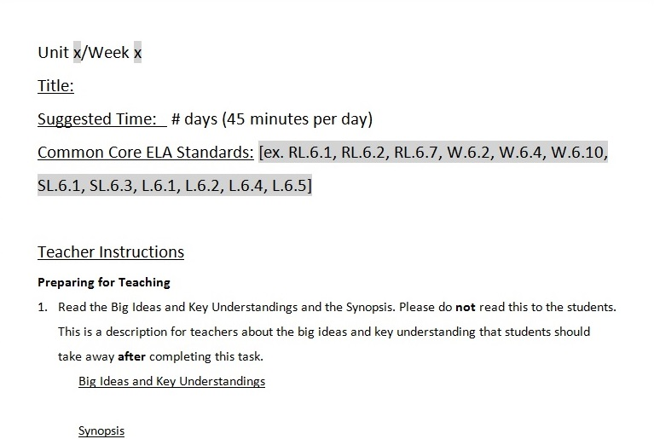
Big Ideas, Key Understandings
Refer to STEP 3 on the “Step-by-Step Checklist for Writers”

Slide 12
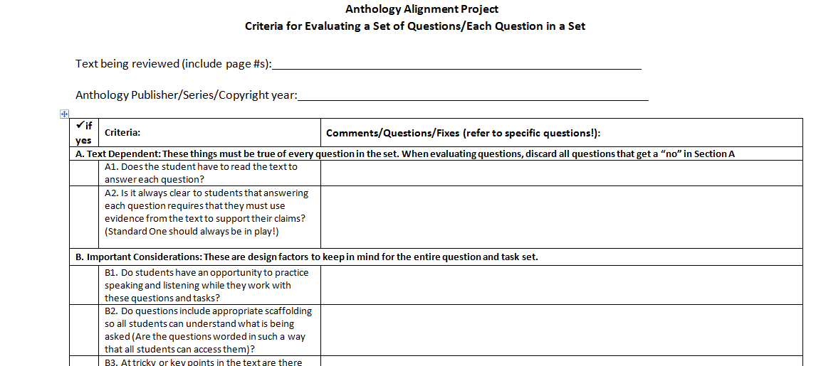
CREATING TEXT-DEPENDENT QUESTIONS: Review, Critique, and Revise
Refer to STEP 4 on the “Step-by-Step Checklist for Writers”

Slide 13
CREATING TEXT-DEPENDENT QUESTIONS
Use the guides and support structures.
Consistency is vital!
Big ideas and key understandings
Culminating activity or activities
Refer to the standards as last step
Finding difficult sections of text
Expect thorough response that reverts to text
Notes:
FINDING DIFFICULT SECTIONS OF TEXT HELPS WITH COMPLEXITY---NOT A FORMULA– WILL NOT ALL BE THE SAME—HOW EXACTLY DOES QUESTION MATCH STANDARD KEEP IN MIND HERE THAT MATCHING UP MANY STANDARDS EACH WEEK—THOROUGH RESPONSE EXAMPLE OF JONATHAN IN EARTHQUAKE STORY WHY HE IS DRAGGING WORRIED ABOUT MOTHER/ISOLATED/CONCERNED ABOUT SISTER—HOW MANY QUESTIONS FOR EACH PASSAGE---QUESTIONS NO ONE CAN ANSWER

Slide 14
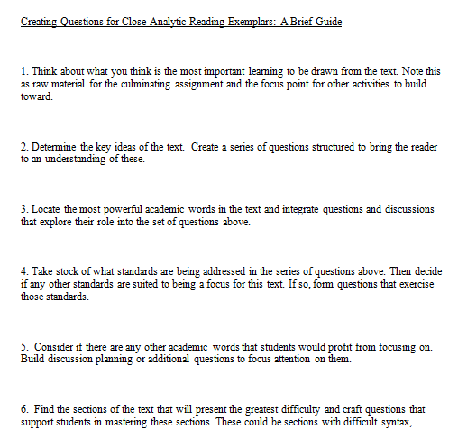
CREATING TEXT-DEPENDENT QUESTIONS
Refer to STEP 4 on the “Step-by-Step Checklist for Writers”
Notes:
FINDING DIFFICULT SECTIONS OF TEXT HELPS WITH COMPLEXITY---NOT A FORMULA– WILL NOT ALL BE THE SAME—HOW EXACTLY DOES QUESTION MATCH STANDARD KEEP IN MIND HERE THAT MATCHING UP MANY STANDARDS EACH WEEK—THOROUGH RESPONSE EXAMPLE OF JONATHAN IN EARTHQUAKE STORY WHY HE IS DRAGGING WORRIED ABOUT MOTHER/ISOLATED/CONCERNED ABOUT SISTER—HOW MANY QUESTIONS FOR EACH PASSAGE---QUESTIONS NO ONE CAN ANSWER

Slide 15
VOCABULARY IS ESSENTIAL
Role in complex text
One of two features of text most predictive of student difficulty (Chall 1996, Stanovich 1986, Nelson et al 2012)
There is a great deal of powerful academic vocabulary in these texts.
(From “Rikki-Tikki-Tavi” low Lexile but in 7th grade Anthology): immensely, paralyzed, insisted, sorrowfully, mournful, revived, cowered, cunningly, consolation, cultivated…
Vocabulary is difficult to catch up but we have to do it!

Slide 16
VOCABULARY
Which words should be taught?
  Essential to text
  Likely to appear in future text
  Which words should get more time and attention?
  More abstract words (persist vs. paralyzed; noticed vs. immense)
      Words which are part of semantic word family (potency, potent, potential, impotent)

Slide 17
VOCABULARY
When should you provide the meaning; when should students determine from context?
How should words be taught?
  Distributed practice
  Use the text
    --Differences (aloof vs. snobby; isolated vs. alone)
    (why this word here and not another?)
Notes:
CAN’T GET INTO THIS HERE. WE CONCENTRATE STUDENT ATTENTION ON IT AS MUCH AS POSSIBLE.
DIFFICULT TO PROVIDE ALL THE ACTIVITIES TO DO THIS--

Slide 18
INTEGRATING VOCABULARY INTO TEXT DEPENDENT QUESTIONS
Rikki-Tikki-Tavi
  When Rikki-tikki asks about Nag, “Darzee and his wife only cowered down in the nest without answering” (p. 125). Based on what you learn about Nag in the next few sentences, why would Darzee and his wife have cowered?
  Read the first sentence (stanza one). What does exulting mean? Who is exulting, and where are they?
On Summer
  On page 656, Hansberry says she worshipped the “cold aloofness of winter.” What does aloofness mean here? What connection can you draw between Hansberry’s desire for an aloof season and her feelings on summer at this point?

Slide 19
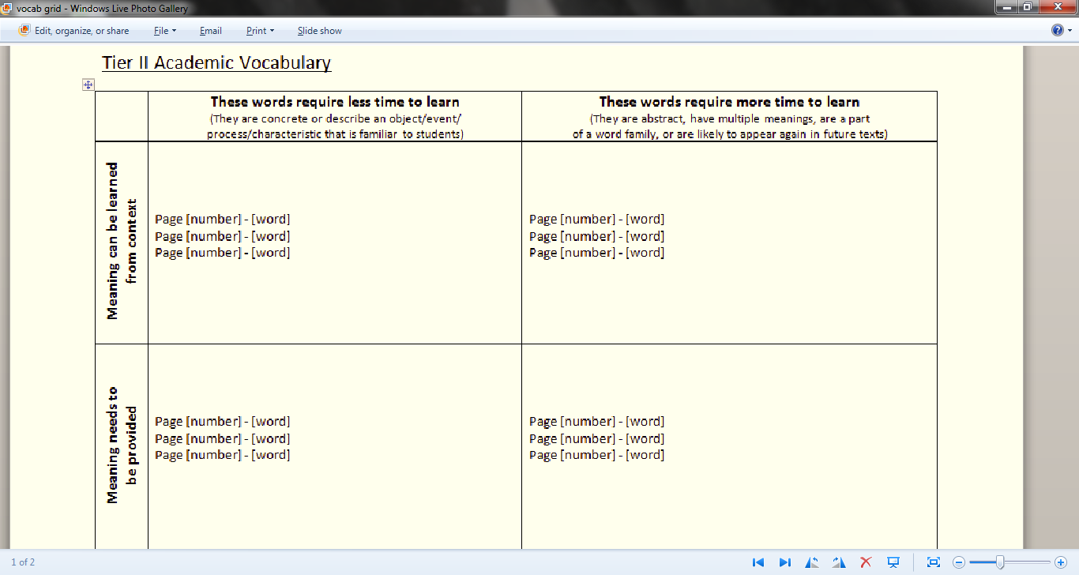
VOCABULARY
How many words to teach?
Refer to STEP 5 on the “Step-by-Step Checklist for Writers”

Slide 20
SYNTAX
Possibly as much as vocabulary predicts student performance
The Anthologies and syntax: an uneven story. Some attend well, some just in the shout outs to ELL instruction, some not at all.
Questions and tasks addressing syntax:
  Paragraph 4. Reread the first sentence of paragraph 4. How many words are in this sentence? What is Douglass saying in this sentence and how does its length strengthen his argument?
  How many lines are in the poem? Record your answer. How many sentences are in the poem?

Slide 21
FLUENCY
Anthologies don’t really address it. We must.
With the arrival of more complex text more students will struggle to read fluently.
We’re essentially facing a tsunami of dysfluency in the upper grades. Secondary teachers are not generally trained to address fluency issues.
How do we address this through AAP?

Slide 22
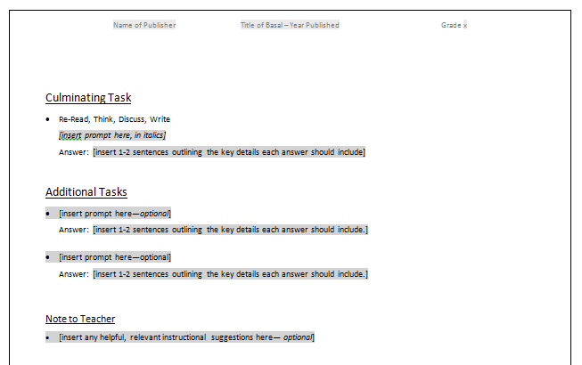
Additional Tasks and Notes
Consider adaptations (i.e.: ELL, SPED) and extension of existing tasks
Refer to STEP 6 on the “Step-by-Step Checklist for Writers”
Notes:
PERFORMANCE TASKS SUCH AS DRAMATIC READ ALOUDS OR READING OF KEY PARTS OF PASSAGE ALOUD TO CITE EVIDENCE ARE WAYS TO BUILD FLUENCY.

Slide 23
CULMINATING TASK
Should relate to big ideas and key understandings
These types of culminating assignments will be a significant shift for students and teachers
No “gotcha”s allowed: revisions must create the conditions for ALL students to be successful with effort.
Writing for Understanding
Refer to STEP 6 on the “Step-by-Step Checklist for Writers”

Slide 24
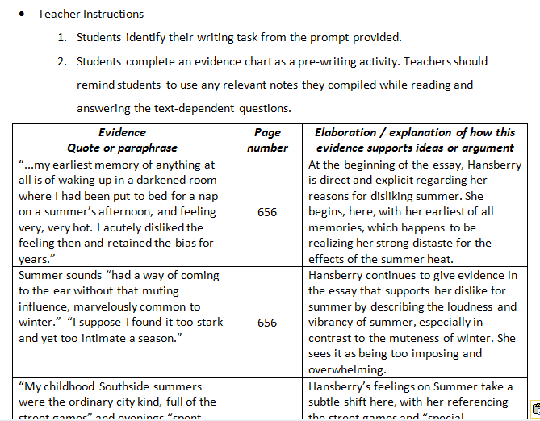
No Gotcha’s Allowed: Supporting Writing
Notes:
REFER TO STEP 6 of the checklist!

Slide 25
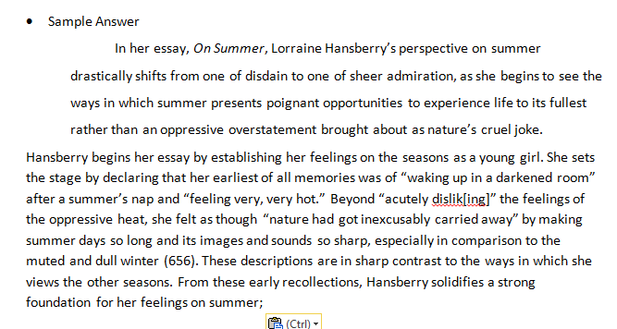
Refer to STEP 6 on the “Step-by-Step Checklist for Writers”

Slide 26
Bands
11-CCR
9-10
6-8
4-5
2-3
K-1
Standard One
Standard Ten
Bands
11-CCR
9-10
6-8
4-5
2-3
K-1
Increased Ability to Use Text Evidence
Increasing Range and Complexity
Standards Two through Nine
Refer to STEP 7 on the “Step-by-Step Checklist for Writers”
Notes:
How the CCSS Reading Standards are created. Evidence and text complexity dominate. They are the Uber Standards. Standards 2-9 are the inferential skills. They are what you ask questions about. Any or all of them can be in play with a given text.

Slide 27
Anthology Alignment Project
Let’s get to work!

